Slide 1

Frailty models
Steve Simon for
Notes:
Analyzing Repeated Measures Data Workshop: Module 5 The Linear Mixed Model
Copyright 2011 The Analysis Factor http://TheAnalysisFactor.com
1

Slide 2
Abstract
Lecture 7.
Lecture 7. Frailty models. You can incorporate multiple events per patient and account for center effects using frailty models, the survival data analysis equivalent to mixed models in linear regression. You’ll see how to define random effects and how to fit and interpret these models.

Slide 3
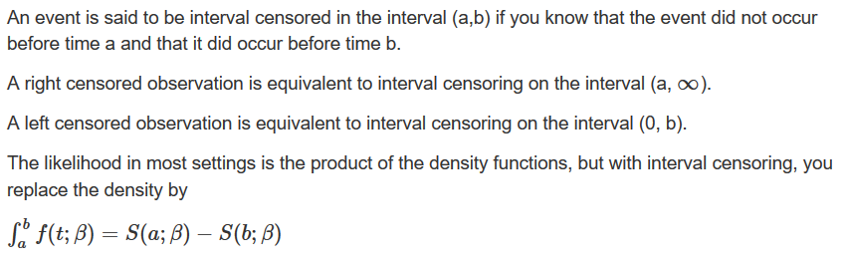
Interval censored data

Slide 4
Interval censored data
Left truncation
In most studies, patients are considered part of the risk set from time 0 to the time that they either die or are censored. But sometimes patients start contributing information about survival only from a certain point forward. This is left truncation.
Example: Patients who die in the hospital are excluded from your sample. A patient contributes to the risk set from the day of discharge onward. Setting the time of discharge to t=0 will mix patients with short and long lengths of stay.

Slide 5
Interval censored data
Left censored and left truncated are opposites
Right censored. Event occurred sometime after last observed time.
Left censored. Event occurred sometime before the first observed time.
Left truncated. The patient does not contribute information about the risk of the event prior to the first observed time.

Slide 6
Psychiatric dataset
math.usu.edu/jrstevens/biostat/projects2013/pres_LeftTruncation.pdf
sex age time death age2
1 female 51 1 death 52
2 female 58 1 death 59
3 female 55 2 death 57
4 female 28 22 death 50
5 male 21 30 censor 51
6 male 19 28 death 47

Slide 7
Psychiatric dataset
Descriptive statistics
7

Slide 8
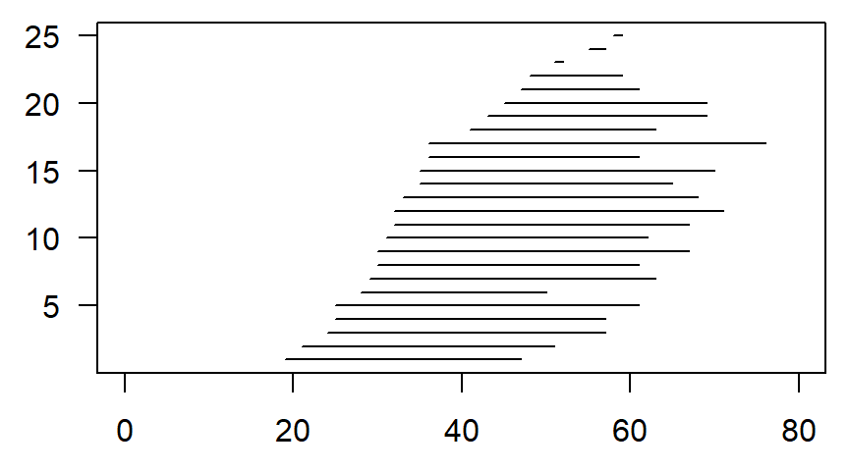
Psychiatric dataset

Slide 9
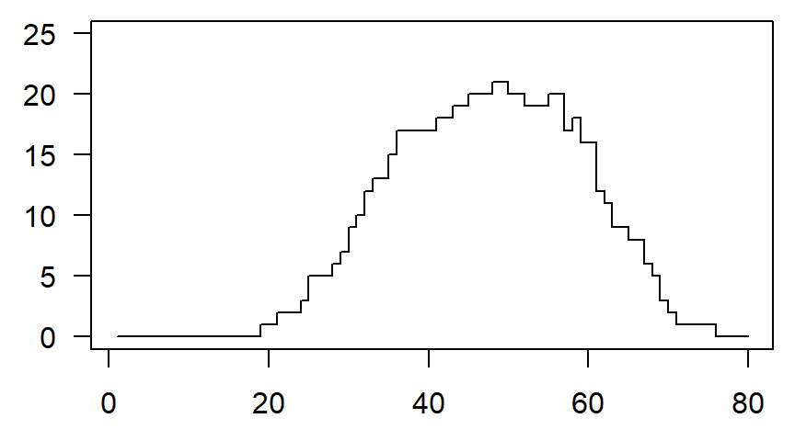
Psychiatric dataset, patients at risk

Slide 10
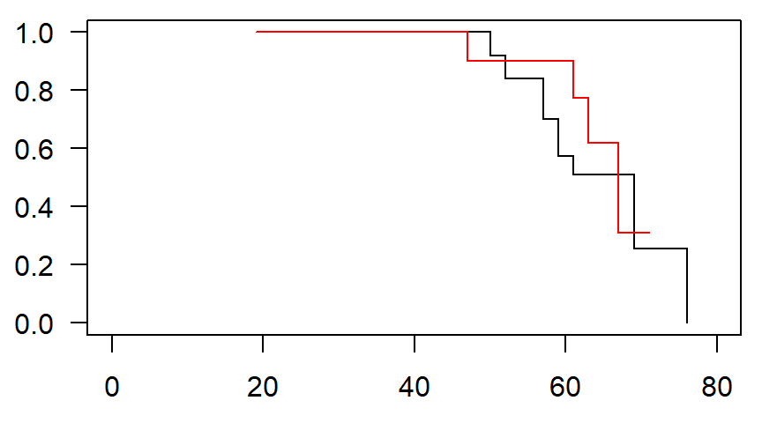
Psychiatric dataset, survival curves

Slide 11
Frailty/cluster models
Settings
Frailty/cluster models account for correlation within a group.
Multiple events for the same person.
Multiple sites on the same person.
Multiple people in the same family
Multiple animals in the same litter.
Multiple visitors in the same hospital
Multiple students in the same classroom/school.

Slide 12
Ashkenazi data set
Description
This is a random subset of data from the Struewing et al. (1997) study of Ashkenazi jews and breast cancer. The subset consists of pairs of first-degree female relatives who are also first degree relatives of a proband.
Struewing JP, Hartge P, Wacholder S, Baker SM, Berlin M, McAdams M, Timmerman MM, Brody LC, and Tucker MA (1997) The risk of cancer associated with specific mutations of BRCA1 and BRCA2 among ashkenazi jews. New England Journal of Medicine 336, 1401-1408.)

Slide 13
Ashkenazi data set
3920 observations and 4 variables
famID: family ID indicator
brcancer: 1 if subject had breast cancer, 0 if not
age: Age at onset of breast cancer, or current age if no breast cancer
mutant: 1 if first degree relative proband was a BRCA mutation carrier, 0 if not

Slide 14
Rats data set
Description
Rat treatment data from Mantel et al. Three rats were chosen from each of 100 litters, one of which was treated with a drug, and then all followed for tumor incidence.
N. Mantel, N. R. Bohidar and J. L. Ciminera. Mantel-Haenszel analyses of litter-matched time to response data, with modifications for recovery of interlitter information. Cancer Research, 37:3863-3868, 1977.

Slide 15
Rats data set
300 observations and 5 variables.
litter: litter number from 1 to 100
rx: treatment,(1=drug, 0=control)
time: time to tumor or last follow-up
status: event status, 1=tumor and 0=censored
sex: male or female

Slide 16
Diabetes data set
Description
The data was collected to test a laser treatment for delaying blindness in patients with diabetic retinopathy. The subset of 197 patiens given in Huster et al. (1989) is used.
Huster W.J. and Brookmeyer, R. and Self. S. (1989) Modelling paired survival data with covariates, Biometrics 45, 145-56.

Slide 17
Diabetes data set
394 observations and 7 variables.
id: a numeric vector. Patient code.
agedx: a numeric vector. Age of patient at diagnosis.
time: a numeric vector. Survival time: time to blindness or censoring.
status: a numeric vector code. Survival status. 1: blindness, 0: censored.
trteye: a numeric vector code. Random eye selected for treatment. 1: left eye 2: right eye.
treat: a numeric vector. 1: treatment 0: untreated.
adult: a numeric vector code. 1: younger than 20, 2: older than 20.

Slide 18
Kidney data set
Description
Data on the recurrence times to infection, at the point of insertion of the catheter, for kidney patients using portable dialysis equipment. Catheters may be removed for reasons other than infection, in which case the observation is censored. Each patient has exactly 2 observations.
CA McGilchrist, CW Aisbett (1991), Regression with frailty in survival analysis. Biometrics 47, 461–66.

Slide 19
Kidney data set
76 observations and 7 variables.
patient: id
time: time
status: event status
age: in years
sex: 1=male, 2=female
disease: disease type (0=GN, 1=AN, 2=PKD, 3=Other)
frail: frailty estimate from original paper

Slide 20
Kidney data set
First six rows.
id time status age sex disease frail
1 1 8 1 28 1 Other 2.3
2 1 16 1 28 1 Other 2.3
3 2 23 1 48 2 GN 1.9
4 2 13 0 48 2 GN 1.9
5 3 22 1 32 1 Other 1.2
6 3 28 1 32 1 Other 1.2

Slide 21
Kidney data set
Descriptive statistics.
status 0 1
18 58
sex 1 2
20 56
disease Other GN AN PKD
26 18 24 8

Slide 22
Kidney data set
Descriptive statistics.
time Min. 1st Qu. Median Mean 3rd Qu. Max.
2.0 16.0 39.5 101.6 149.8 562.0
age Min. 1st Qu. Median Mean 3rd Qu. Max.
10.0 34.0 45.5 43.7 54.0 69.0
frail Min. 1st Qu. Median Mean 3rd Qu. Max.
0.200 0.600 1.100 1.184 1.500 3.000
## Min. 1st Qu. Median Mean 3rd Qu. Max.
## 0.200 0.600 1.100 1.184 1.500 3.000

Slide 23
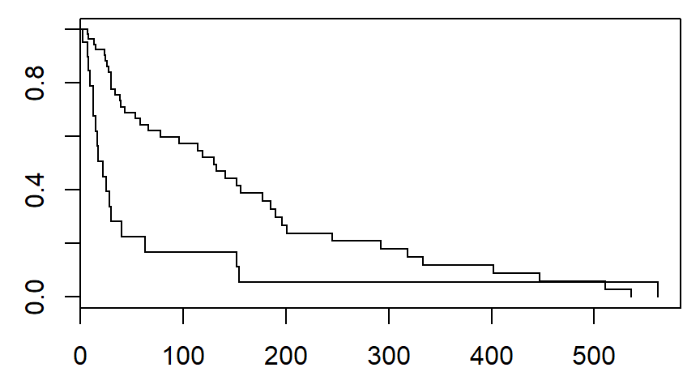
Kidney data set

Slide 24
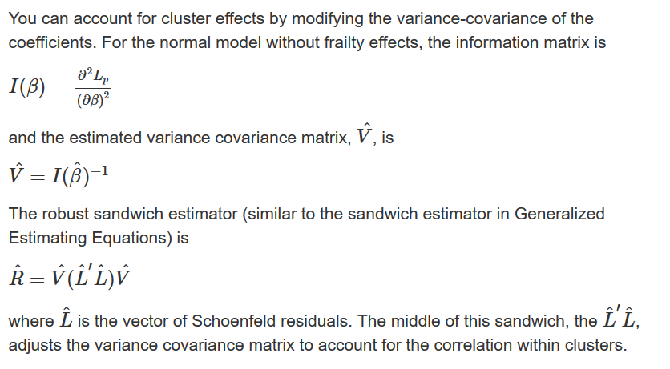
Cluster models

Slide 25
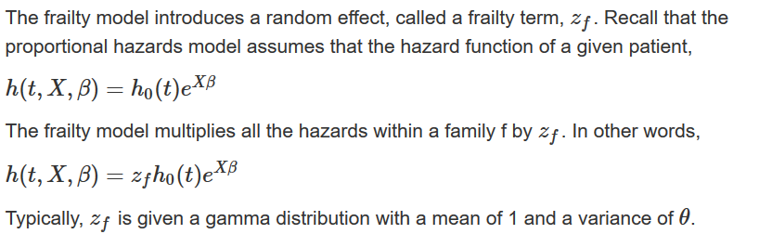
Frailty models

Slide 26
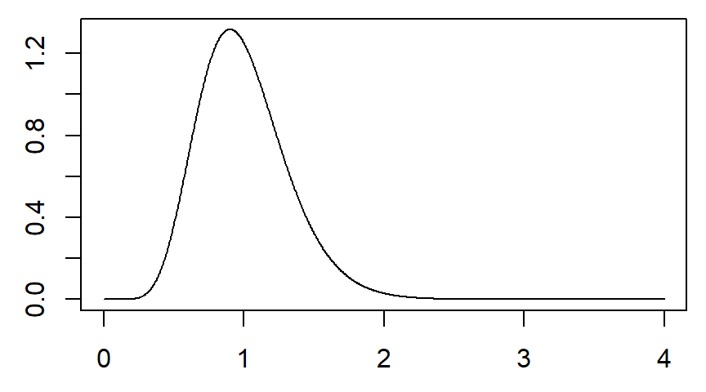
Frailty models

Slide 27
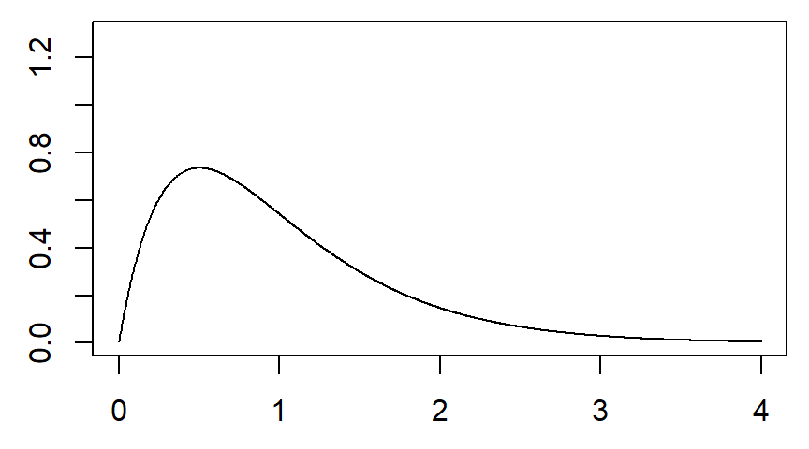
Frailty models

Slide 28
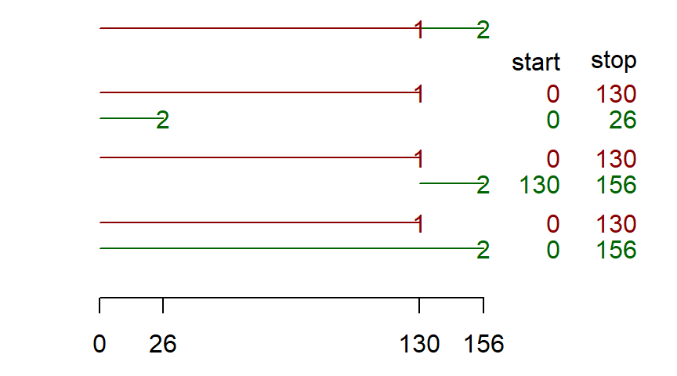
Three models for repeated events

Slide 29
Conclusion
What have you learned today?

